Slide 1
Structura unui site – cuvinte cheie
Olivian BREDA
Orange Concept Store, 2009.05.23

Slide 2

Sursa: http://www.flickr.com/photos/chrism70/3006405416/

Slide 3
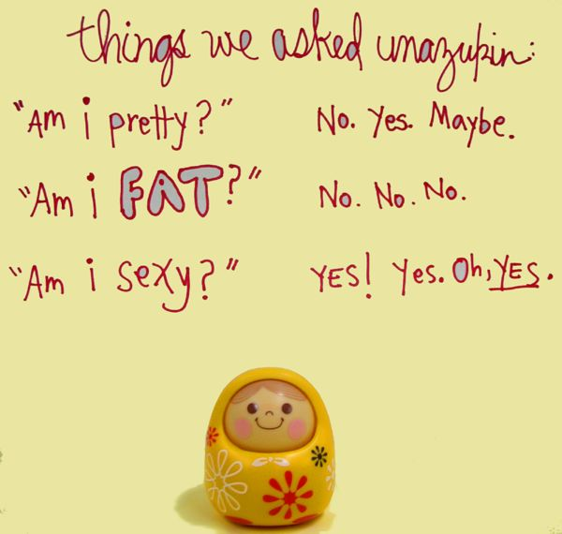
Sursa: http://www.flickr.com/photos/santos/112390837/

Slide 4
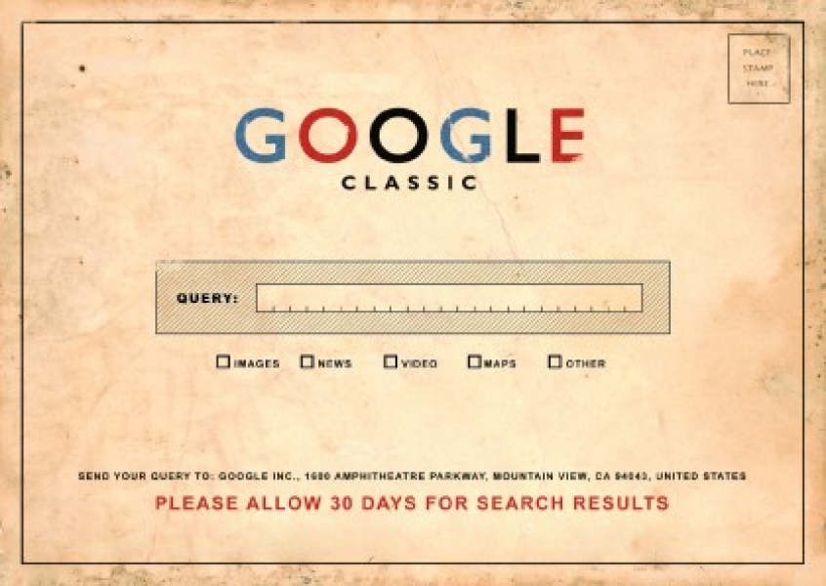
Sursa: http://www.flickr.com/photos/dullhunk/3389581452/

Slide 5
Sursa: http://www.flickr.com/photos/santos/112390837/

Slide 6

Sursa: http://www.flickr.com/photos/lawrence_evil/145786038/

Slide 7
Sursa: http://www.flickr.com/photos/santos/112390837/

Slide 8

Sursa: http://www.flickr.com/photos/ivanomak/2208129715/

Slide 9
Sursa: http://www.flickr.com/photos/santos/112390837/

